Slide 1

COLOR
1. Debasis Ganguly | 2. Priyangshu Saha | 3. Abhradeep Guin | 4. Niloy Majumdar
5. Sayan Mondal | 6. Megha Mondal | 7. Arijit Mondal

Slide 2
Contents
Topic | Slide No.
Chromaticity | 3
Color Systems – RGB, HLS, HSV, CMYK | 15
Color Cubes | 38
Transformation Between Color Systems | 44

Slide 3
Chromaticity

Slide 4

Introduction to Chromaticity
Colors surround us—but what defines their 'pure' form, independent of brightness? Chromaticity is the answer. It’s the foundation of color science, influencing everything from display technology to artistic design. Today, we’ll explore how chromaticity shapes our perception of color.

Slide 5

Definition
Chromaticity refers to the quality of a color regardless of its brightness. It describes the hue (the type of color, such as red, green, or blue) and saturation (the purity or intensity of the color), but not the luminance (brightness).
Chromaticity is a property that characterizes the color quality of an object seen by the human eye and gives a measure of how well the human eye sees an object.
In technical terms, chromaticity is represented using two values that define where a color lies on a chromaticity diagram, such as the CIE 1931 chromaticity diagram, which uses (x, y) coordinates derived from the full color's tristimulus values (X, Y, Z).

Slide 6
Key Properties of Chromaticity
Hue:
This is what we usually think of as the “color” itself—like red, green, blue, yellow, etc. The dominant wavelength of light determines it. For example, a color with a dominant wavelength around 480 nm appears blue.
Saturation:
This tells us how pure a color is. A fully saturated color has no addition of white light and looks vivid or intense. As saturation decreases, the color appears more washed out or faded (closer to gray).
Key Point:
"Together, hue and saturation define chromaticity—brightness is irrelevant here!"

Slide 7
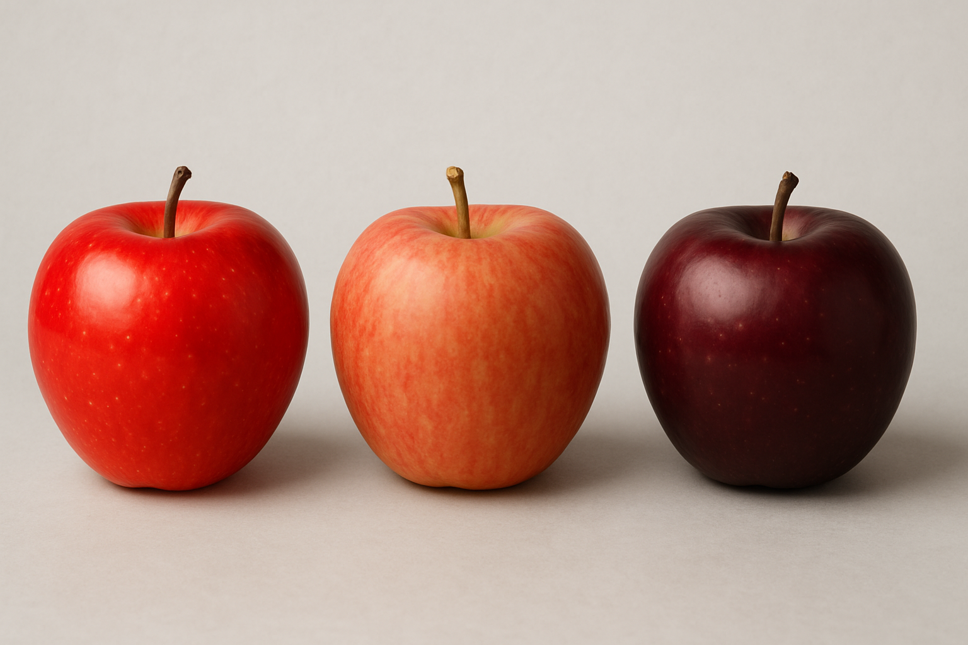
Real-World Example
A bright red apple (high saturation).
A faded red apple (same hue, lower saturation).
A dark red apple (same chromaticity as the first, but lower brightness).
Content:
Notice how the two red apples share the same chromaticity (hue + saturation) but differ in brightness. The faded apple has different chromaticity (lower saturation). Chromaticity helps standardize color across devices, ensuring ‘red’ looks consistent whether dim or bright.

Slide 8
The CIE 1931 Chromaticity Diagram
When we plot the normalized amounts x and y for colors in the visible spectrum, we obtain the tongue-shaped curve shown in figure below. This curve is called the CIE(Commission Internationale de l'Éclairage) chromaticity diagram.
Next figure is a two-dimensional representation of hue and saturation in the
X-Y plane.

Slide 9
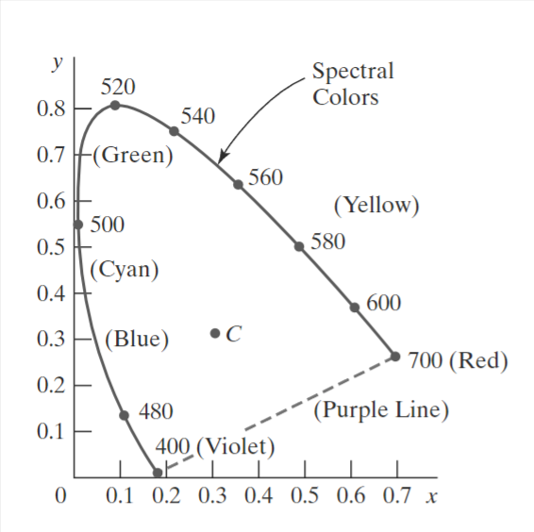
Points along the curve are the spectral colors (pure colors).
The line joining the red and violet spectral points, referred to as the purple. The line is not part of the spectrum. Interior points represent all possible visible colors combinations.
Point C in the diagram corresponds to the white-light position. This point is plotted for a white light source known as illuminant C, which is used as a standard approximation for average daylight.
Luminance values are not available in the chromaticity diagram. Colors with different luminance but with the same chromaticity map to the same point.

Slide 10
USES OF THE CHROMATICITY diagram
Comparing color gamuts for different sets of primaries.
It also helps identify complementary colors, which are pairs that can produce white light when mixed in the right amounts.
The diagram even allows us to find a color’s dominant wavelength, essentially tracing its connection to a specific spectral color.

Slide 11
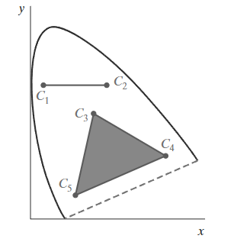
Color Gamuts
A color gamut is the range of colors that can be created by mixing specific base (primary) colors.
All colors along the straight-line joining points C1 and C2 in the figure can be obtained by mixing appropriate amounts of the colors C1 and C2. If a greater proportion of C1 is used, the resultant color is closer to C1 than to C2. The color gamut for three points, such as C3, C4, and C5 in the figure, is a triangle with vertices at the three color positions. These three primaries can generate only the colors inside or on the bounding edges of the triangle. Thus, the chromaticity diagram helps us understand why no set of three primaries can be combined to generate all colors, because no triangle within the diagram can encompass all colors.

Slide 12
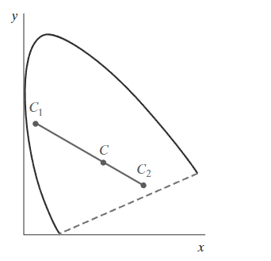
Complementary Colors
Complementary colors are two colors that produce white light when mixed in the right amounts.
The color gamut for two points is a straight line, and complementary colors must be represented on the chromaticity diagram as two points on opposite sides of C and collinear with C, as in the figure. The distances of the two colors C1 and C2 to C determine the amounts needed to produce white light.

Slide 13
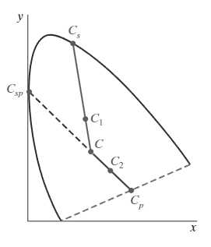
Dominant wavelength
For Most Colors (e.g., C₁):
1. Draw a line from white (C) through the color (C₁) to the spectral curve.
2. The intersection point (Cₛ) gives the dominant wavelength.
3. The color is a mix of white (C) and spectral color (Cₛ).
For Colors Between White (C) and the Purple Line (e.g., C₂):
1. The line from C through C₂ hits the purple line (Cₚ) (non-spectral).
2. Use the complementary wavelength (Cₛₚ) on the spectral curve (opposite side).
3. The color is described as white light (C) minus Cₛₚ.

Slide 14
Formula for Subtractive Dominant Wavelength:
For colors like C₂ (between C and the purple line):
Color C2​=White Light C−Spectral Color Csp This means the color is what remains when you remove Csp from white light.

Slide 15
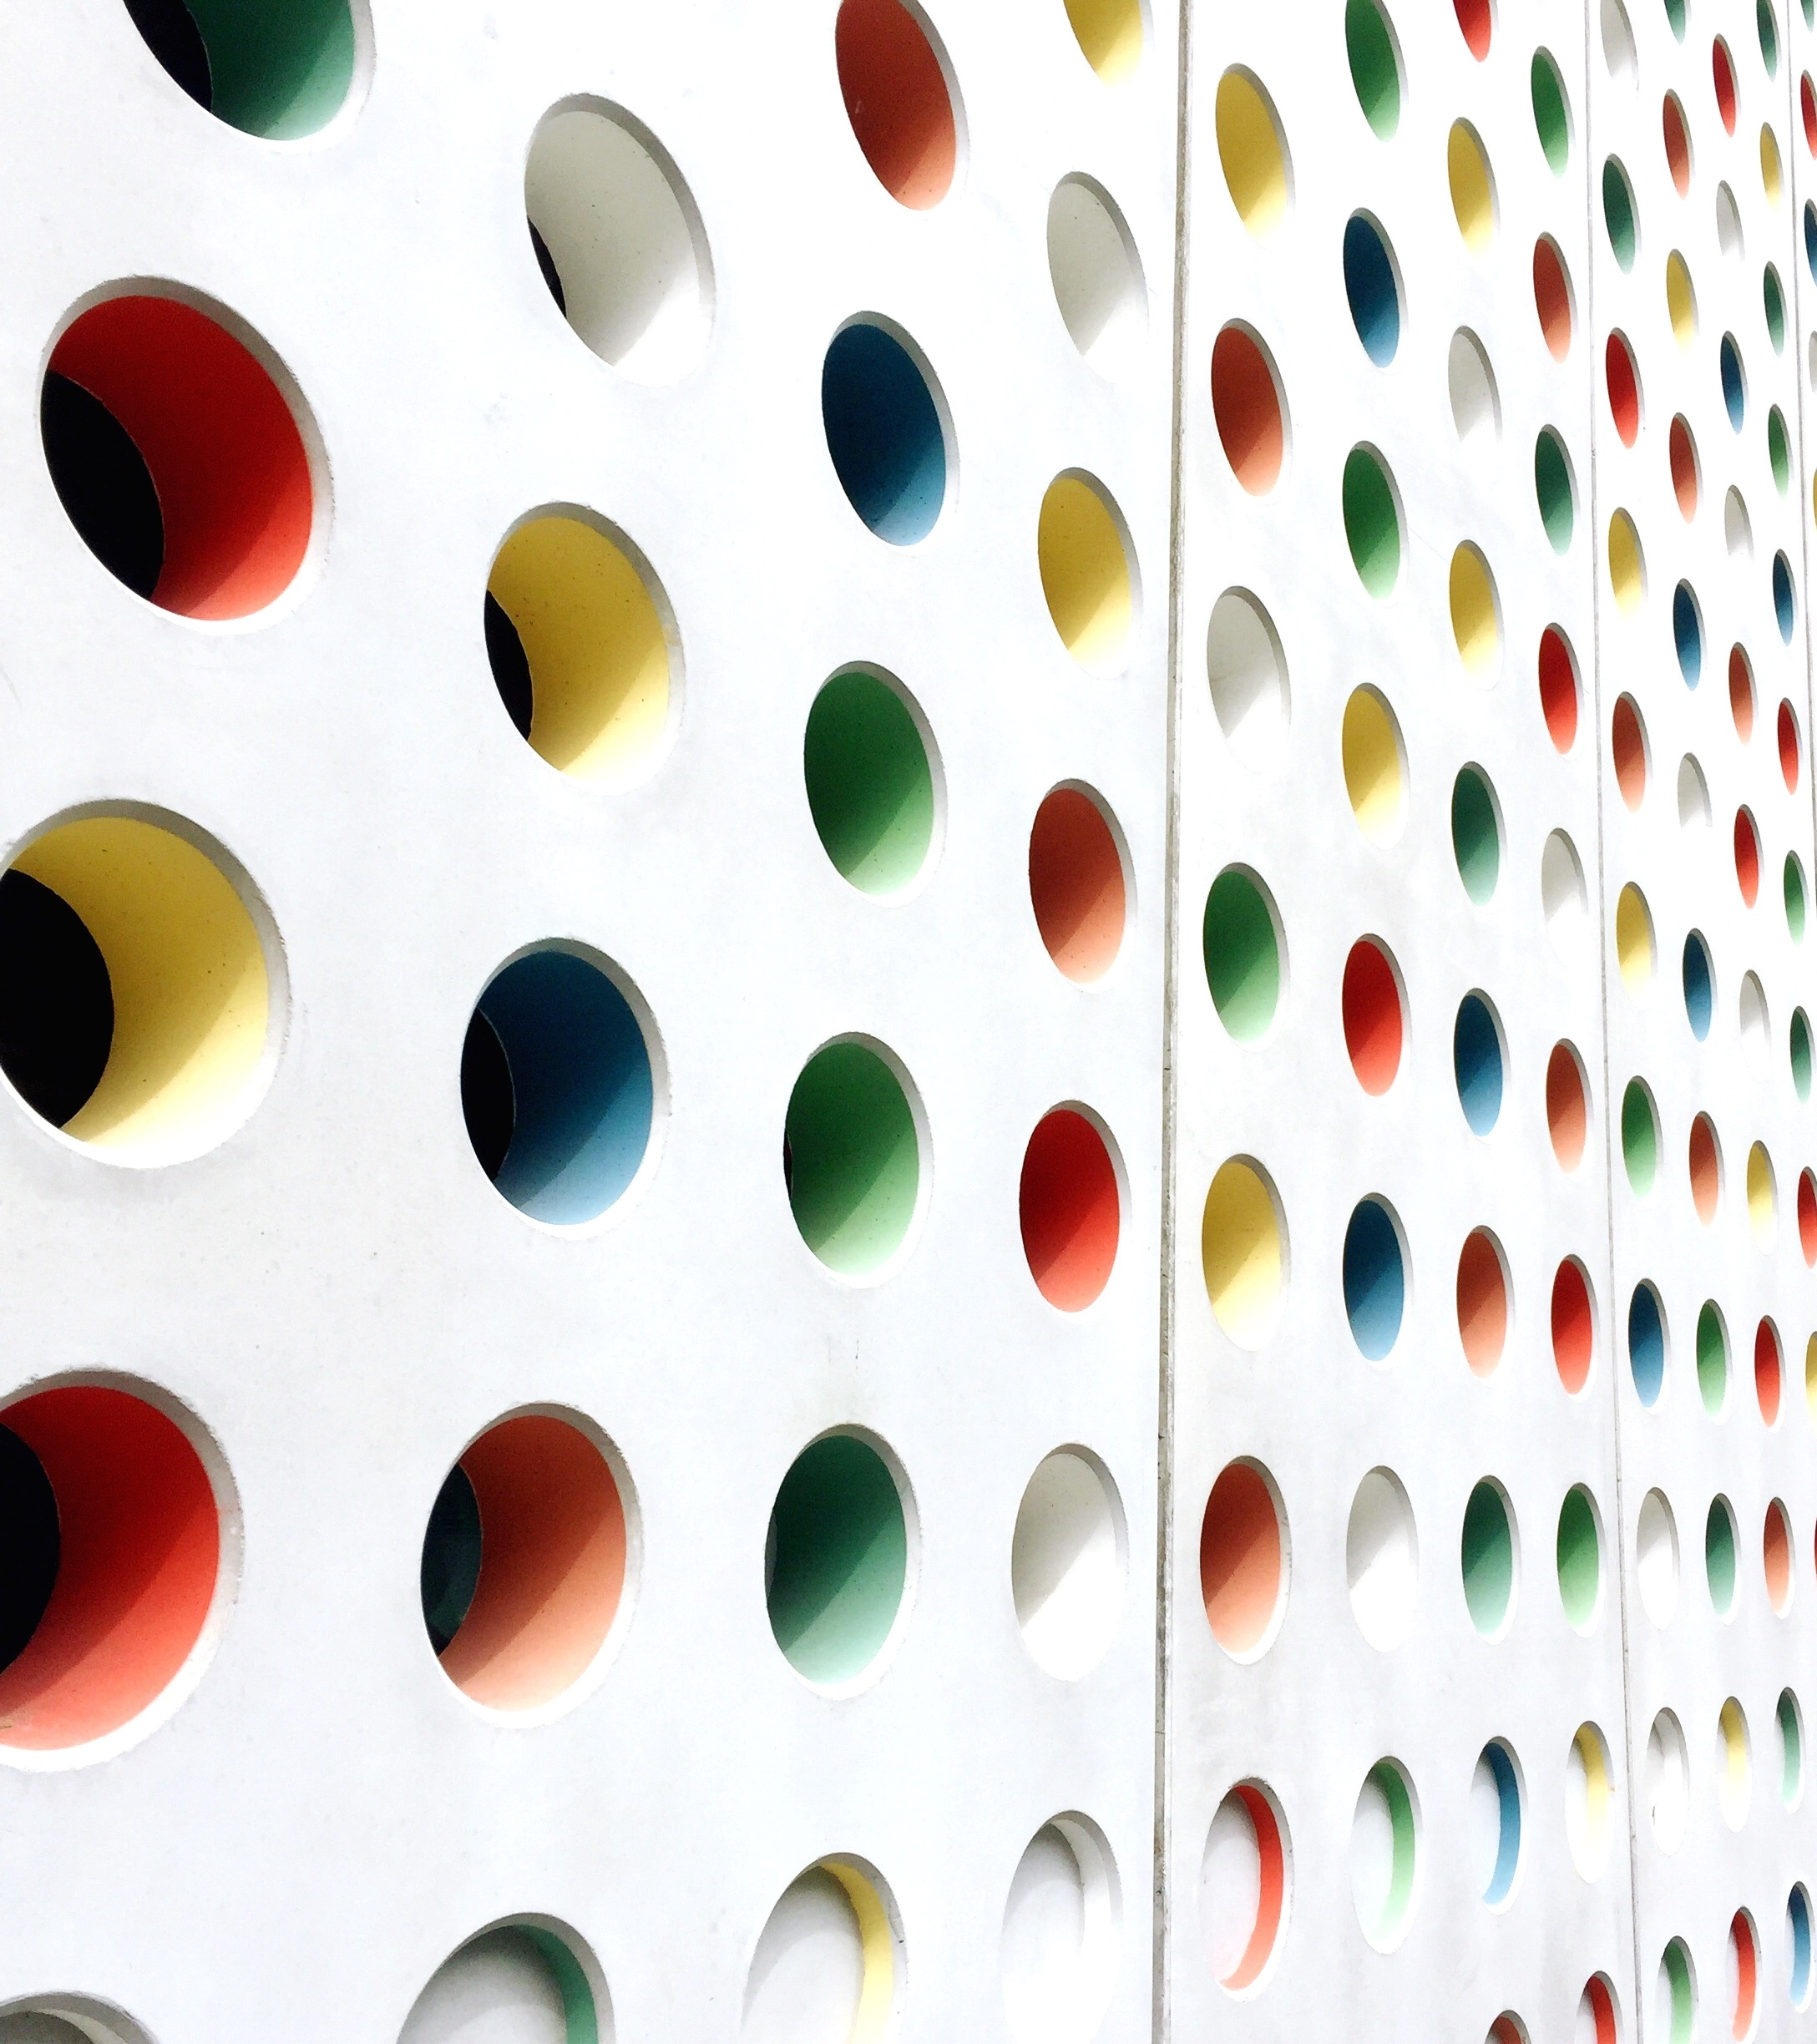
Color System
RGB
HSL

Slide 16
RGB
HSL
CMYK
HSV
Types of Color Model

Slide 17
RGB Color Model
A color model is a structured method to generate a full spectrum of colors using a few primary ones. It converts colors into numerical values through mathematical formulas.
Red = #ff0000, Green = 00ff00, Blue = 0000ff

Slide 18
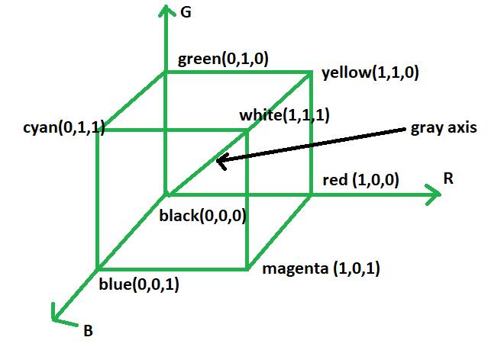
RGB Color Model
Each color is represented by its primary color components: Red, Green, and Blue.
This model is based on Cartesian Coordinate System.

Slide 19
RGB Color Model
Additive color model.
For computer displays.
Uses light to color display.
Colors result from transmitted light.
Red + Green + Blue = White.

Slide 20
Additive Color
Additive color is a method of creating color by mixing different wavelengths of light, typically red, green, and blue (RGB). It’s called “additive” because the more light you combine, the brighter the result becomes — and when all three primary colors are combined at full intensity, the result is white light. This model is used in digital displays, TVs, and projectors, where colors are formed by directly emitting light, not reflecting it.

Slide 21
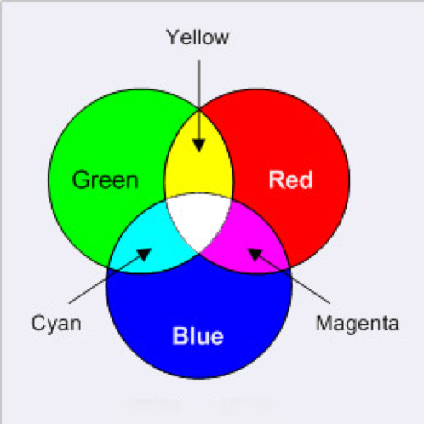
Example of Additive Color
This model is called additive, and the colors are called primary colors.
The primary colors can be added to produce the secondary colors of light- Magenta(Red + Blue), Cyan(Green + Blue), and Yellow(Red + Green). The combination of Red, Green and Blue at full intensities makes white.

Slide 22
HSL Color Model
HSL Stands for
Hue
Saturation
Lightness

Slide 23
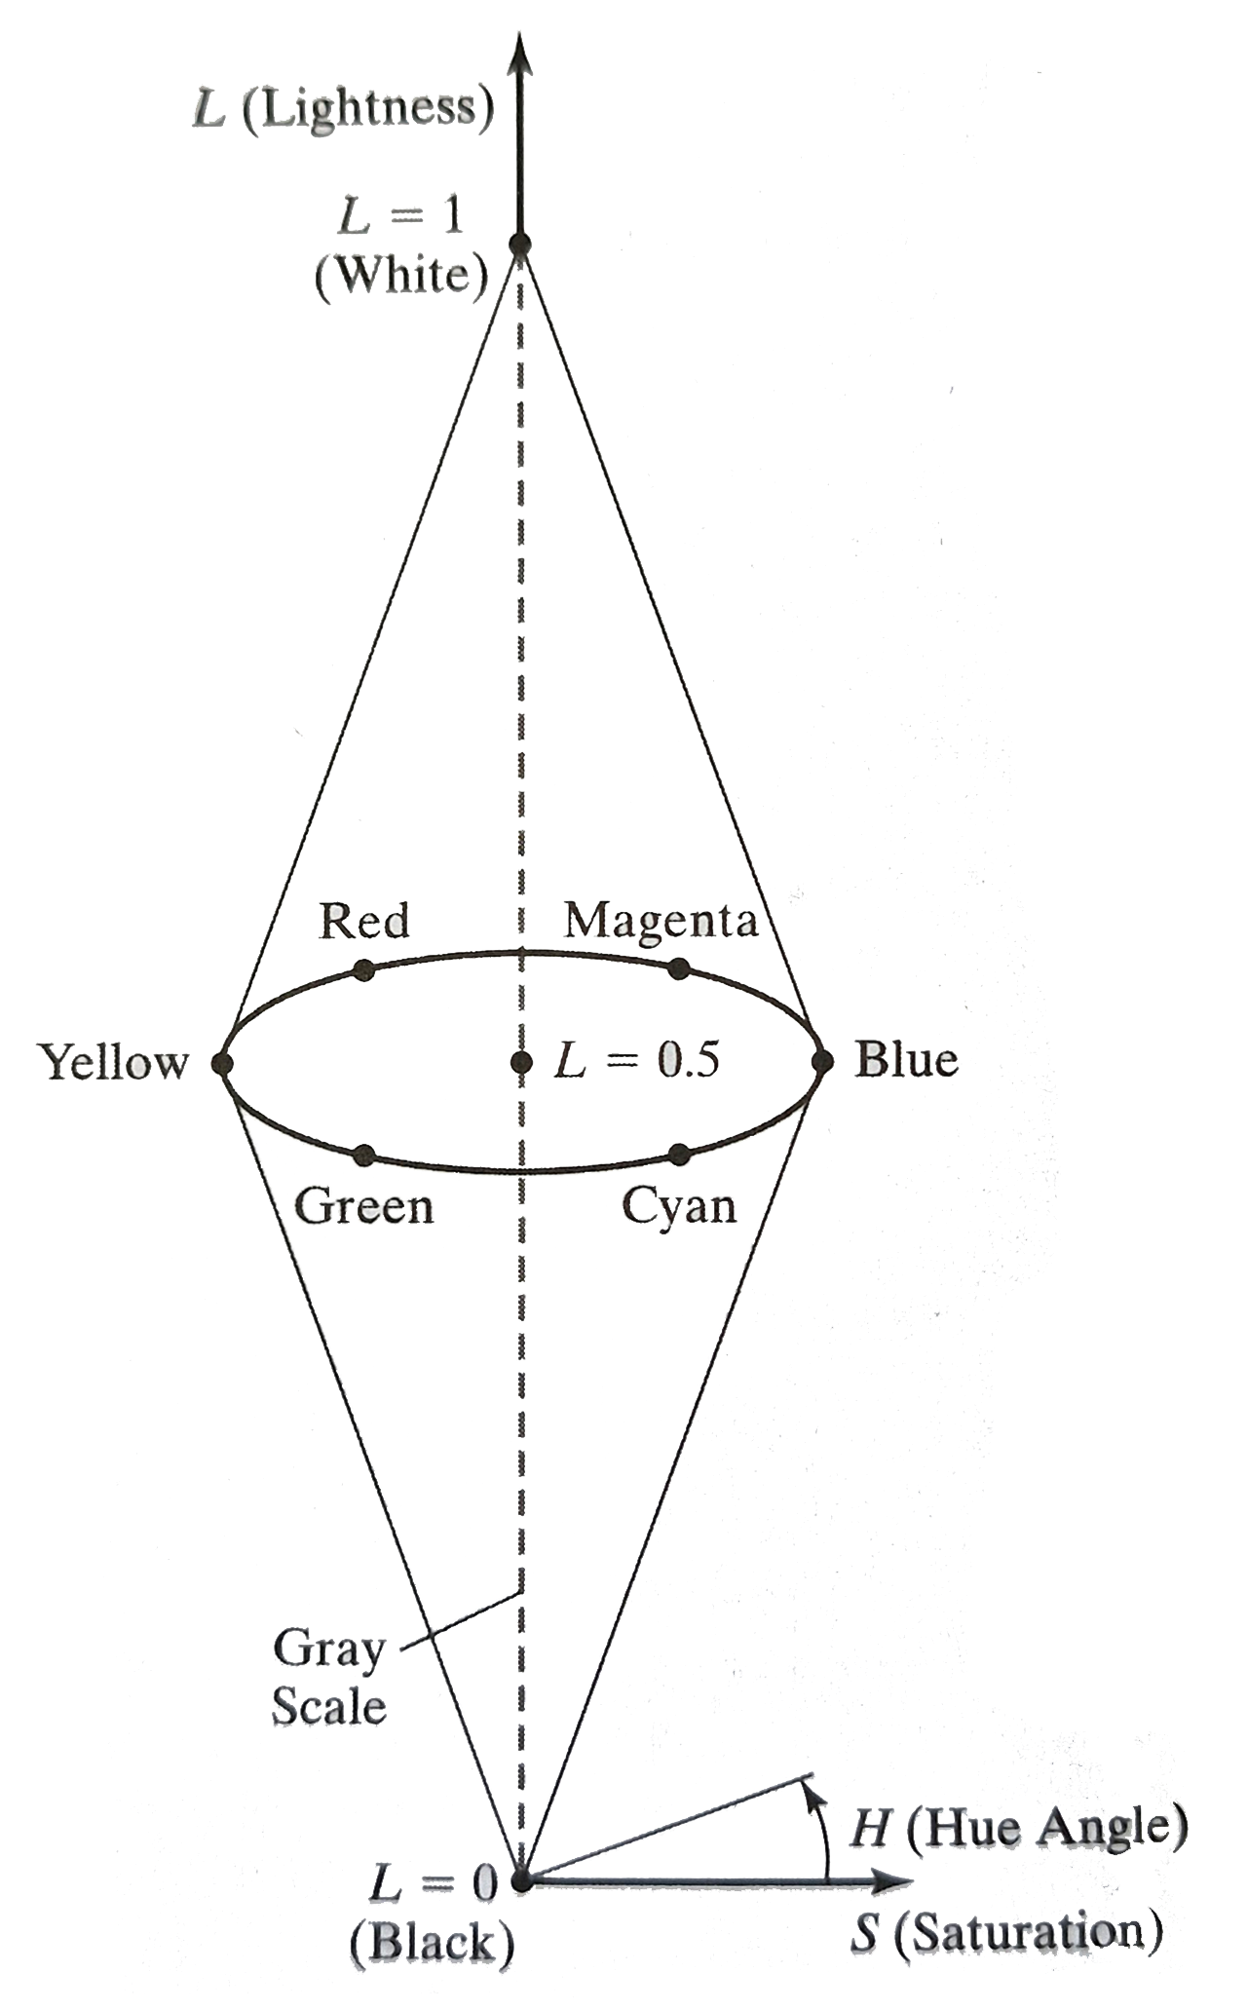
Hue
The angle around the central vertical axis corresponds to hue.
Saturation
The distance from the central axis corresponds to saturation.
0% - Grey & 100% - Full sat
Lightness
The distance along the central axis corresponds to lightness
0% - Black & 100% - White
Red = 0 = 360, Green = 120, Blue = 240

Slide 24
Advantages
East to understand color-wise
More intuitive that RGB
Great for adjusting brightness or tint
Helpful in design & theming
Disadvantages
Not widely supported in older tools
Can be harder to compute precisely
Less precise for real-world color mixing
Not device-dependent (can cause inconsistencies)

Slide 25
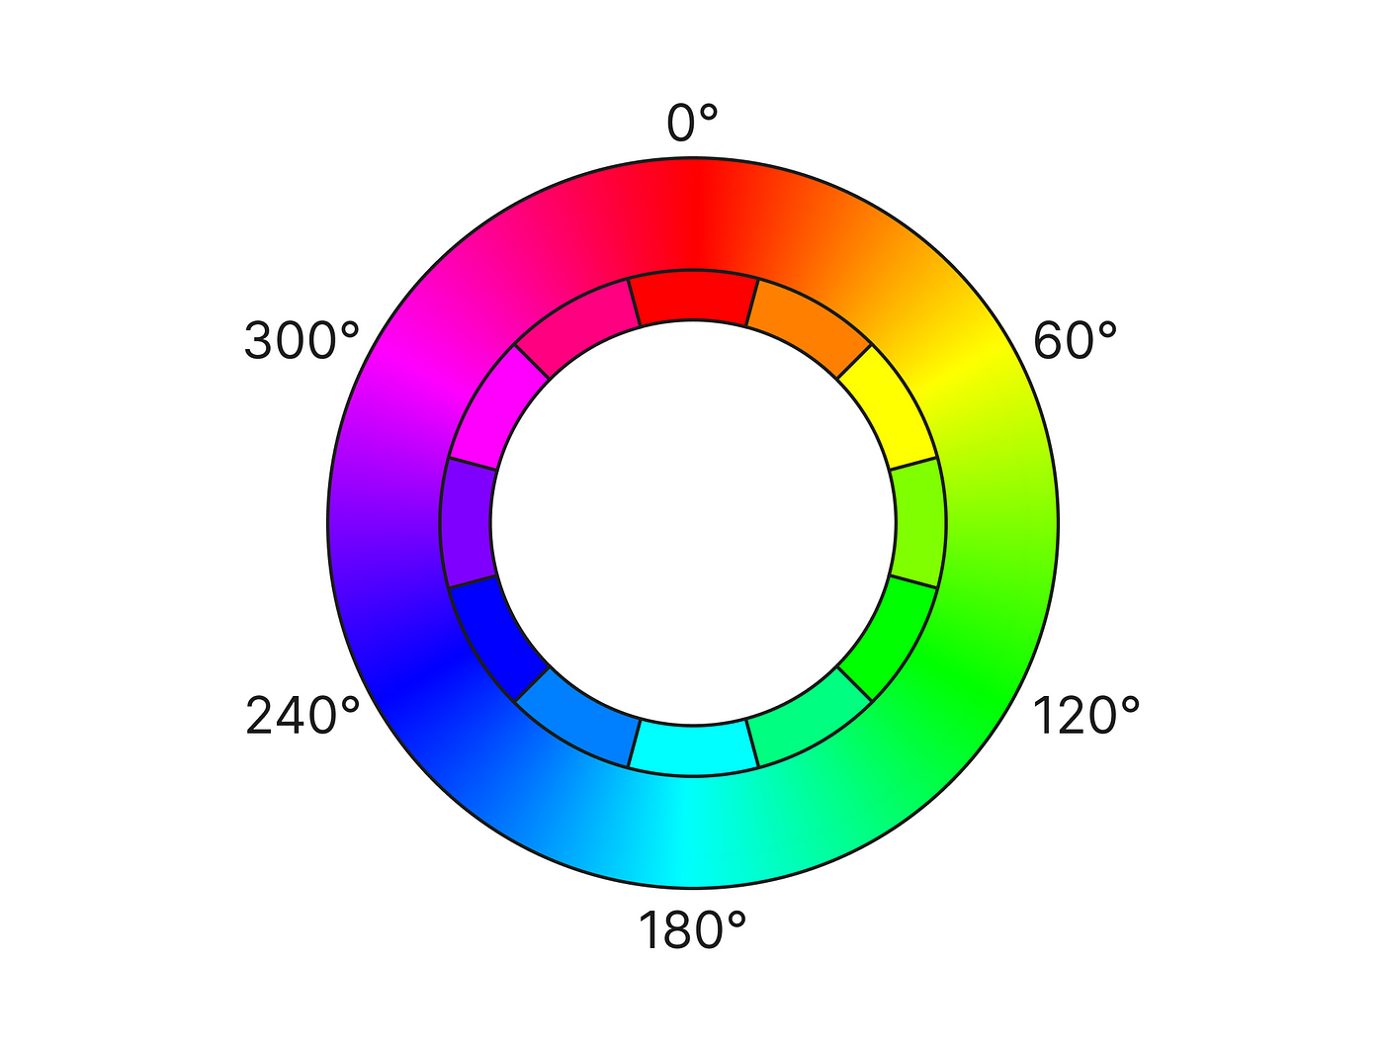



What is HSV?
HSV stands for Hue, Saturation and Value.
Hue
Type of color, degrees 0°–360°.
Red: 0°, Green: 120°, Blue: 240°
Saturation
Color intensity, range 0–1.
0 = gray (no color), 1 = full color
Value
Brightness, range 0–1.
0 = black, 1 = brightest color

Slide 26
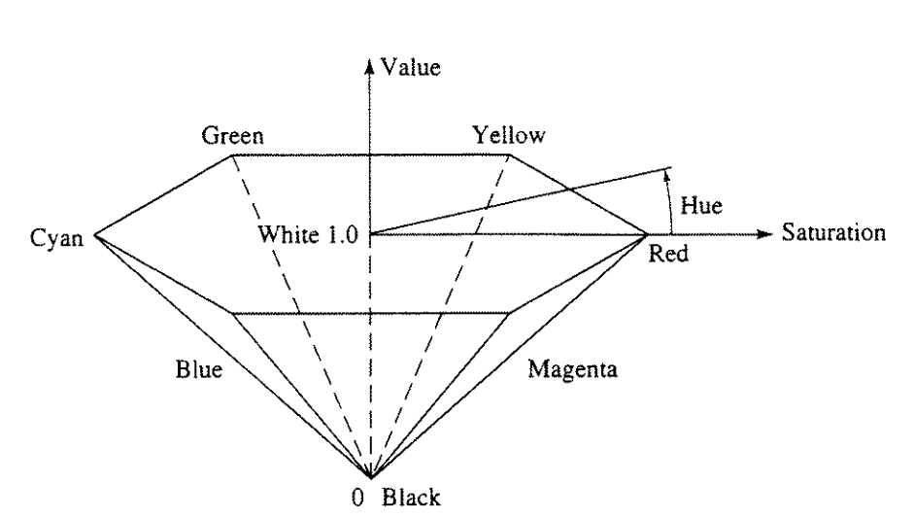
Advantages Over RGB
RGB is device-oriented
Defines color in terms of light intensities
HSV is perception-oriented
Closer to how humans perceive and describe colors
Easier to manipulate for:
Tinting/shading , Filtering, and Artistic purposes

Slide 27
RGB vs HSV Comparison
Feature
RGB
HSV
Based on
Primary colors of light
Human color perception
Components
Red, Green, Blue
Hue, Saturation, Value
Ease of Use
Less intuitive
More intuitive for artists
Applications
Monitors, displays
Color pickers, image processing

Slide 28
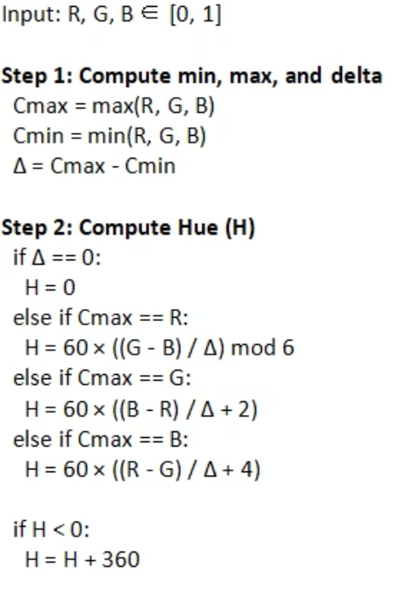
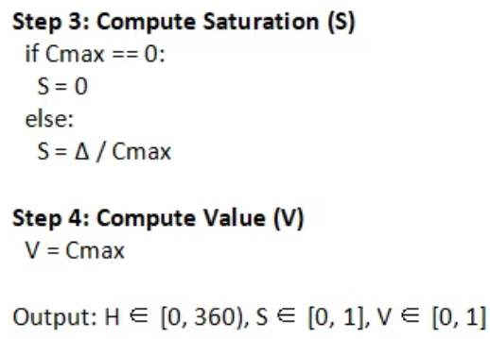
Converting RGB to HSV

Slide 29
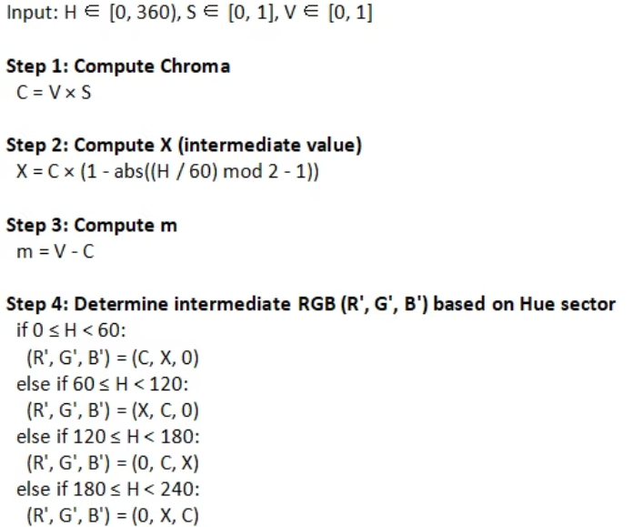
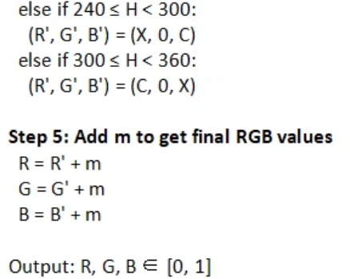
Converting HSV to RGB

Slide 30
Applications & Limitations of HSV
Applications
Limitations
Computer vision: object & skin detection
Not perceptually uniform
Image editing: intuitive sliders
Artifacts in filtering
Web design: color pickers for CSS
Alternatives: HSL, RGB, CMYK

Slide 31
Understanding the CMYK Color Model
CMYK stands for Cyan, Magenta, Yellow, and Key (Black).
It is a subtractive color model mainly used in color printing.
[ C M Y ] = [ 1 1 1 ] - [ R G B ].

Slide 32
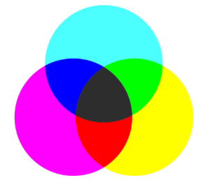



How CMYK Works
Subtractive Mixing
Colors form by absorbing light wavelengths
Starts with White
Subtract colors from the white paper base
Black (K) Ink
Adds depth, contrast, and ink efficiency

Slide 33
CMYK vs RGB: Basic Differences
Feature
CMYK
RGB
Model Type
Subtractive
Additive
Used For
Printing
Digital screens
Base Color
White (paper)
Black (screen)
Color Components
Cyan, Magenta, Yellow, Black
Red, Green, Blue

Slide 34
Advantages of CMYK
Print Accuracy
Shading & Gradients
Precise color reproduction on physical media
Smoother handling of tonal variations
Efficient Black Ink
Industry Standard
Cost-effective shadows and text clarity
Extensive support in professional printers

Slide 35
Disadvantages of CMYK
Smaller color gamut than RGB
CMYK's limited range restricts vibrant reproduction especially for screens and digital media.
Not suited for bright digital colors
Conversion can cause color shifts

Slide 36
Color Cubes
Understanding RGB and Color Representation in Computer Graphics

Slide 37
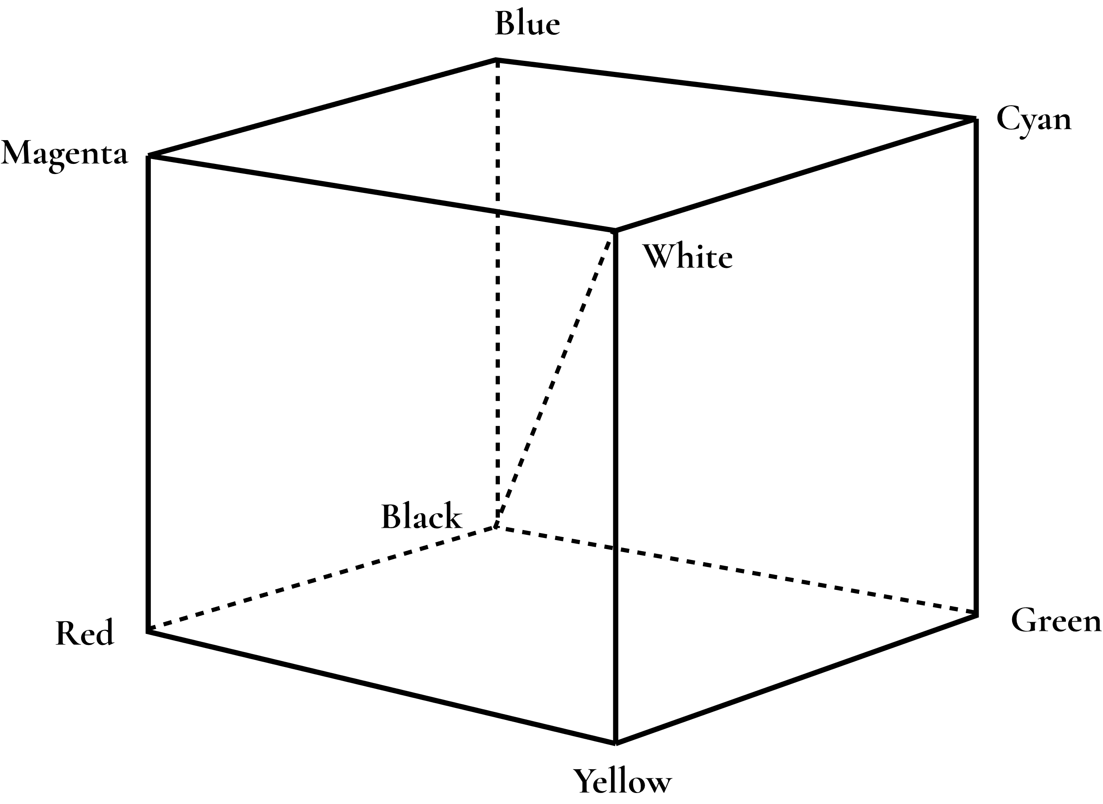
What is Color Cube
A Color Cube is three-dimensional representation where each axis corresponds to one of the primary colors in RGB or CMY model.
For RGB,
For CMY,
X – Axis: Red (0 – 255)
Y – Axis: Green (0 – 255)
Z – Axis: Blue (0 – 255)
X – Axis: Cyan (0 – 255)
Y – Axis: Magenta (0 – 255)
Z – Axis: Yellow (0 – 255)

Slide 38
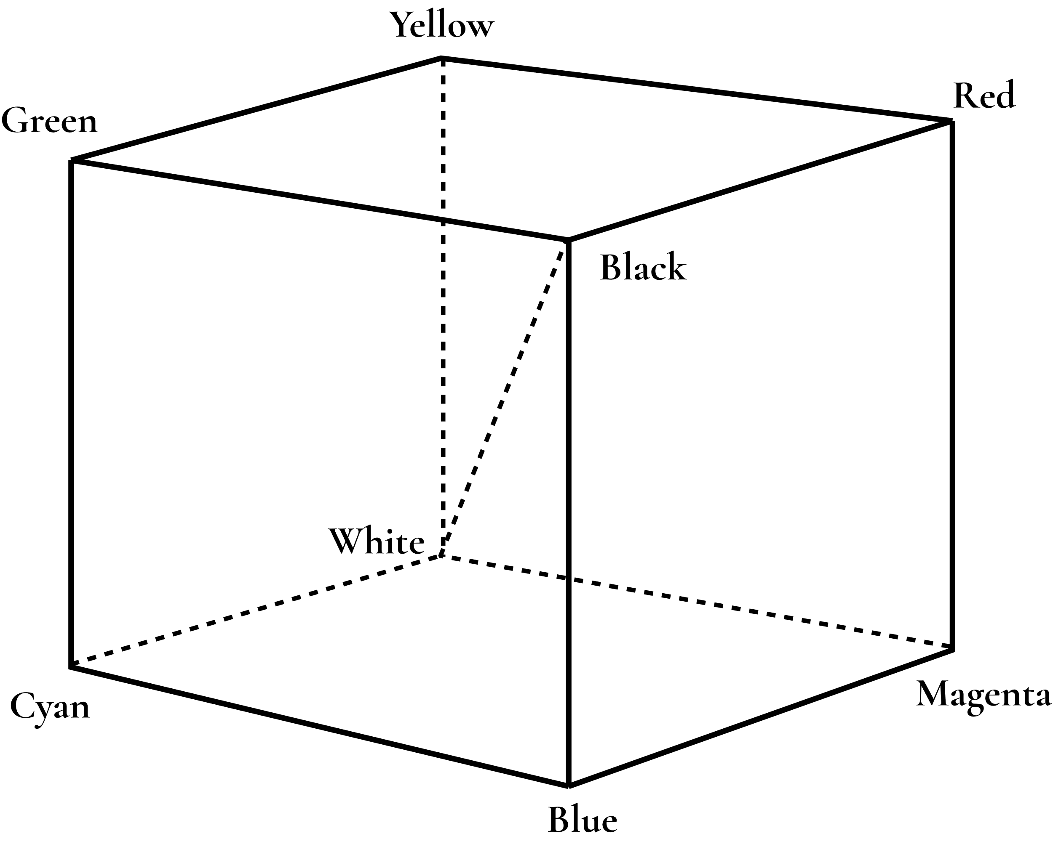
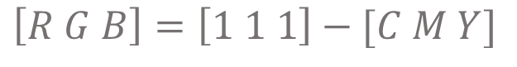
RGB and CMY Color Cube
The RGB Cube uses Black as the origin and CMY uses White as the origin. Cube opposite for RGB is White and for CMY is black.
$$\left[R G B\right]=\left[1 1 1\right]−[C M Y]$$

Slide 39
Structure of a Color Cube
The structure of a RGB color cube:
The X-Axis defines red color, Y-Axis defines green color and Z-Axis defines blue color.
Each axis contains 256 intensity levels (0–255) for its respective color. For example, the Z-axis includes shades from pure black (0) to pure blue (255).
The 8 corners of the cube represent extreme color combinations (pure colors and combinations like white and black).
The diagonal from (0,0,0) to (255,255,255) represents the grayscale line, where all color components are equal (R = G = B).
The face diagonals represent secondary colors:
Diagonal between red and green = shades of yellow.
Diagonal between red and blue = shades of magenta.
Diagonal between green and blue = shades of cyan.
RGB Color Cube

Slide 40
RGB Color Representation
Every other point within or on the surface of the RGB color cube represents a different color, which is defined by its unique red, green and blue values.
We can represent colors with inter values from (0 – 255) or normalized float values (0.0 – 1.0).
Pure Primary Colors: Points along each axis, away from the origin and towards the maximum value, represent the pure primary colors: red (R max, G 0, B 0), green (R 0, G max, B 0), and blue (R 0, G 0, B max).
Secondary Colors: The corners of the cube adjacent to white represent the secondary colors, which are formed by mixing two primary colors at full intensity:
Yellow: Red + Green (R max, G max, B 0)
Cyan: Green + Blue (R 0, G max, B max)
Magenta: Red + Blue (R max, G 0, B max)
For example:- A color is represented as (50, 160, 35). This means, it will go:
50 towards X-Axis (Red)
160 towards Y-Axis (Green)
35 towards Z-Axis (Blue)
The color in that point inside cube will be selected.
RGB(50, 160, 35) looks like:

Slide 41
Applications of Color Cube
In computer graphics, everything we see is a color. And most of them uses RGB color model. The RGB Color Cube is used in:
Color Selection tools: Color cubes are used to select one color from many. Software like Photoshop, GIMP uses color cubes to select colors.
3D Modeling and Rendering: In computer graphics, objects are often colored using RGB values. The color cube provides a framework for defining and interpolating colors across surfaces and during rendering processes.
Usage in GLUT library:
Pure red color representation –
glColor3f(1.0, 0.0, 0.0) // using float values
glColor3ub(255, 0, 0) // using integers

Slide 42
Transformation Between Color Systems

Slide 43
Introduction to Color Systems
In computer graphics, colors are represented numerically. Different color models (or systems) represent colors using different numerical formats tailored for specific applications like display, printing, or image processing.
What is a Color System (Model)?
A Color System is a way to represent, describe, and reproduce colors in a standard format. Examples:
RGB (Red, Green, Blue)
CMY (Cyan, Magenta, Yellow)
CMYK (Cyan, Magenta, Yellow, Black)
HSV (Hue, Saturation, Value)
HSL (Hue, Saturation, Lightness)
YUV, YIQ (used in video)
CIE XYZ (perceptual color spaces)

Slide 44
Need for Color System Transformation
Devices interpret color differently.
Different color systems serve different applications (e.g., RGB for display, CMYK for printing).
For accurate color rendering when images move between devices/systems.
Useful in tasks like:
Image enhancement
Video editing
Computer vision
Medical imaging

Slide 45
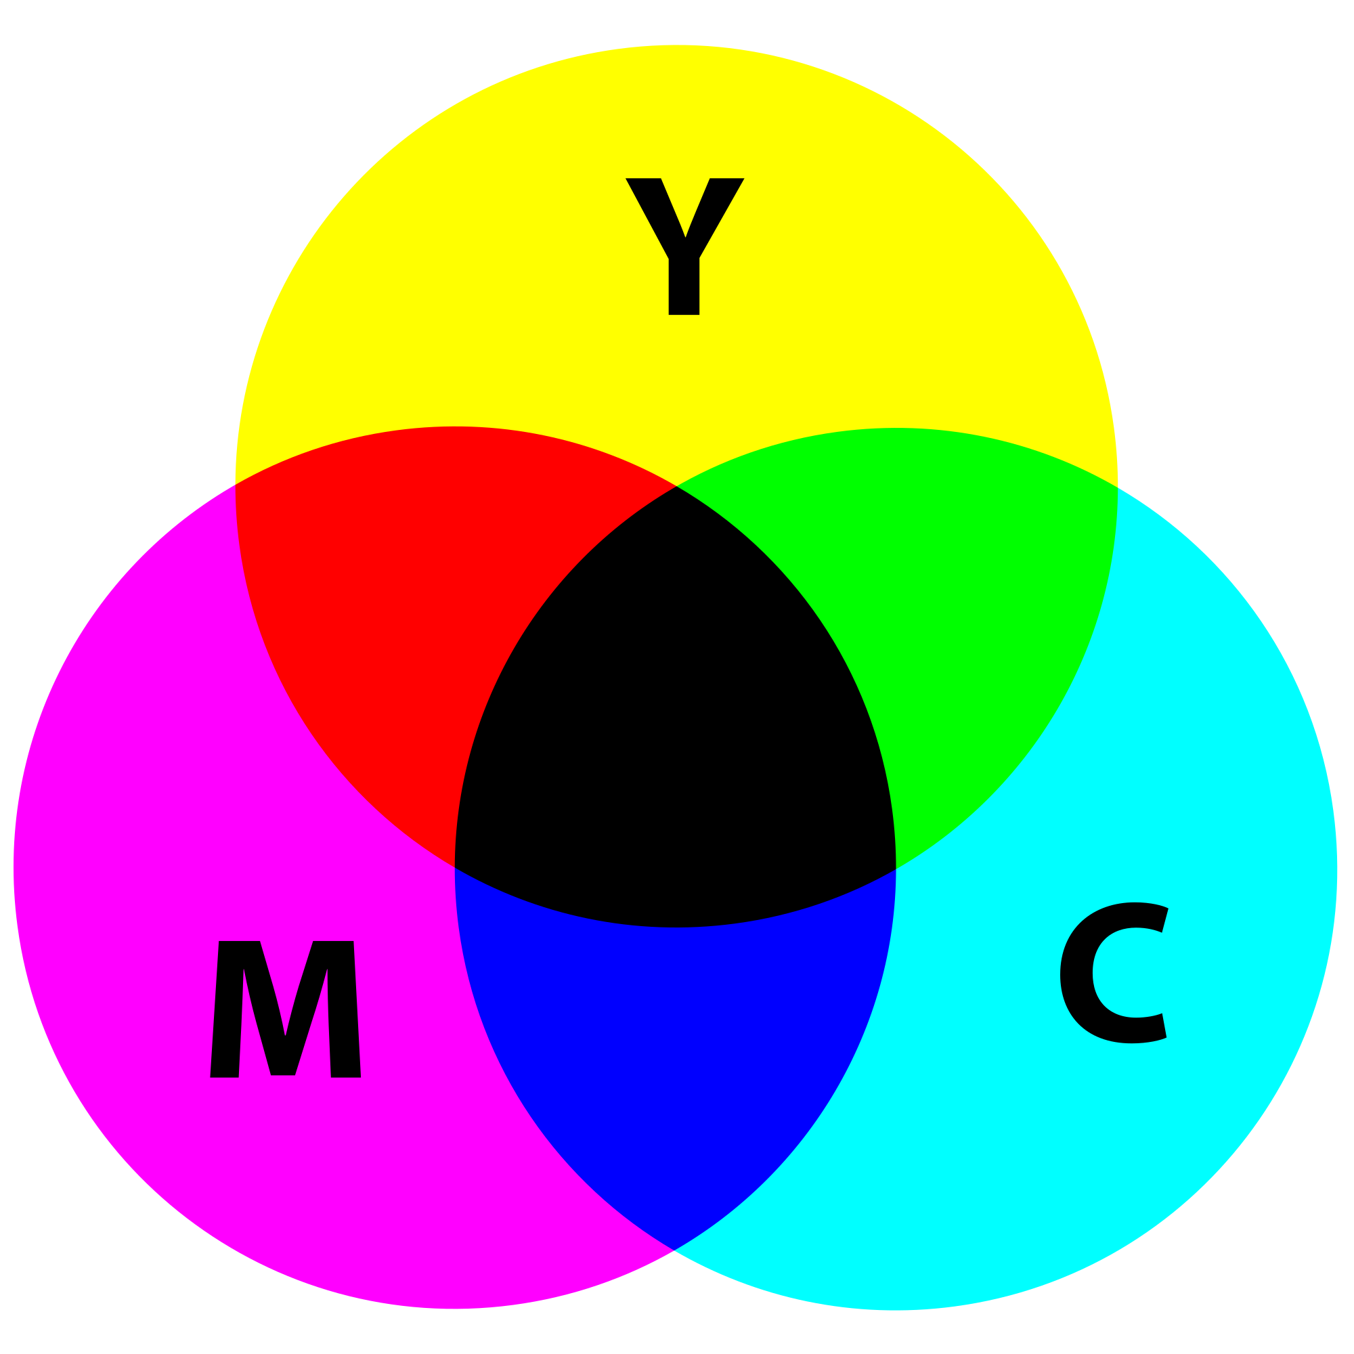
🎨 RGB to CMY
Purpose: Convert colors for printing systems, as printers use CMY (Cyan, Magenta, Yellow) inks which absorb light (subtractive model), while screens use RGB (Red , Green , Blue).
Formulas:
C=1−R
M=1−G
Y=1−B
Note: Input RGB values should be in the range 0–1.0
(if in 0–255, divide by 255 first).
🎨 CMY to RGB
Purpose: Reverse of RGB to CMY — converts print colors back to display format.
Formulas:
R=1−C
G=1−M
B=1−Y

Slide 46
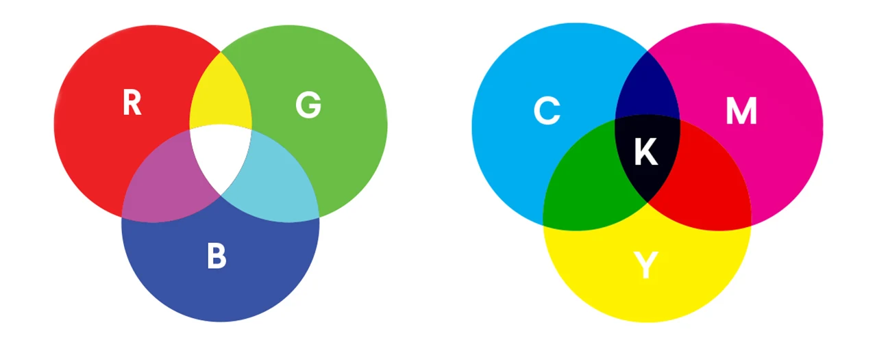
🎨 RGB to CMYK
C = Cyan
M = Magenta
Y = Yellow
K = Key(Black)
The K (black) component improves contrast and saves ink.
RGB to CMYK conversion :-
Normalize the RGB to [ 0,1]:-
R’ = R/255 , G’ = G/255 , B’ = B/255
2. Calculate K (Black key component ):-
K = 1- max( R’ , G’, B’ )
3. Calculate C , M , Y :-
C = 1 - R’ - K / 1-K
M = 1 - G’- K/ 1-K
Y = 1 - B’ - K / 1- K

Slide 47

🎨 RGB to HSV:
H = Hue (Type of color (0°–360°))
S = Saturation (Intensity or purity of the color (0–1))
V = Value (Brightness of the color (0–1))
Conversation RGB to HSV :-
V = Max = max(R,G,B)
similarly Min = min (R,G,B)
S = (Max – Min) / Max or S = 0 if V = 0
0 + (G-B) /(Max – Min ) , if Max = R
H = 60 * 2 + (B - R) /(Max – Min ) , if Max = G
4 + (R- G) /(Max – Min ) , if Max = B
If the result is negative then ,
H = H + 360 [ To get the positive Hue ]

Slide 48
🎨 RGB to HSL :
H = Hue (Type of color (0°–360°))
S = Saturation (Color intensity (0–1))
L = Lightness (Brightness of the color (0–1))
RGB to HSL Conversion :
Normalize the RGB to [ 0,1] :
R’ = R/255 , G’ = G/255 , B’ = B/255
2. Calculate Cmax , Cmin , Δ :
Cmax = max (R’,G’,B’)
Cmin = min (R’,G’,B’)
Δ = ( Cmax – Cmin )
3. Calculate Lightness :
L = (Cmax + Cmin) / 2
4. Calculate Saturation :
S = Δ / 1- |2L -1|
5. Calculate Hue:
H = 60 * { 0 + (G’- B’) / Δ} (If Cmax = R’)
H = 60 * { 2 + (B’-R’) / Δ} (If Cmax = G’)
H = 60 * { 4 + (R’-G’) / Δ} (If Cmax = B’)

Slide 49
Applications of Color Transformations
1. Image Processing
Adjust brightness, contrast, and color balance by converting to different color spaces (e.g., RGB to HSL, HSV).
Perform color-based segmentation (like separating skin tones or object colors).
Apply color corrections and filters.
2. Digital Photography
When cameras capture photos and software processes them.
Camera saves images in RGB format.
But sometimes colors look weird (too blue or dark ) so we convert them to HSL or LAB .
3. Printing
Convert RGB images to CMYK for accurate color reproduction on paper.
Compensate for ink absorption and paper color.

Slide 50
Challenges in Color Transformation:
1. Device Dependency -
Different devices (monitors, printers, projectors, cameras) use different color models and have varying color gamuts (the range of colors they can display or capture).
Example: A color that looks vibrant on a smartphone display might appear dull or inaccurate when printed.
Issue: Without proper color management systems (CMS), colors can shift or lose consistency between devices.
2. Gamut Limitations -
Each color model or device has a limited color gamut — a subset of all possible colors visible to the human eye.
Example: RGB displays can reproduce bright, saturated colors well, while printers using CMYK may struggle with the same.
Issue: When transforming colors from one gamut to another, some colors might fall outside the target gamut (called out-of-gamut colors) and need to be approximated, leading to potential color shifts.

Slide 51
3. Precision and Rounding Errors -
Most color transformations involve mathematical operations and floating-point calculations.
Issue: When converting between color models (like RGB to CIE XYZ), small rounding errors can accumulate, especially if colors undergo multiple transformations in a workflow, leading to slight inaccuracies or shifts.
4. Computational Complexity -
Some color transformations, like RGB to CIE LAB via CIE XYZ, involve nonlinear functions and matrix multiplications.
Issue: In real-time applications like video games or simulations, high-complexity color transformations can affect performance and responsiveness.

Slide 52
References
Procedural Elements of Computer Graphics - Book by David F. Rogers
Computer graphics with OpenGL - Book by Donald Hearn and M. Pauline Baker
Google - https://google.com/
GeeksforGeeks - https://www.geeksforgeeks.org/
YouTube - https://youtu.be/g16GEhJXr4U?si=pNMfvgoZJCodL5ad
ChatGPT - https://chatgpt.com

Slide 53
Thank You

